Slide 1
Enhanced Pizza Delivery Analysis
Data Analysis using Python, SQL & Power BI
- By Asma Khan

Slide 2
Problem Statement
Which pizza type has the highest number of delays?
Which restaurant experiences the most delays?
Does the weekend have any impact on pizza delays?
Which restaurant receives the highest number of orders?
Which payment methods are most commonly used in different locations?
How do order counts vary across months?
In which month are the highest and lowest number of orders placed?
In which month is the delay count highest and lowest?

Slide 3
Tools & Approach
Tools Used:
SQL – Data storage and cleaning.
Python – Exploratory Data Analysis (EDA) and initial analysis.
Power BI – Data visualization and dashboard creation.
Approach:
Data Storage & Cleaning: Stored the dataset in SQL and cleaned the data using SQL.
Exploratory Data Analysis (EDA): Connected SQL to Python and used Python to analyze patterns and trends from SQL data.
Data Visualization: Imported the cleaned data from SQL into Power BI and created interactive dashboards to answer business questions.

Slide 4
Key Metrics
Total Orders – 1004
Minimum Delay – 9.00 min
Maximum Delay – 30.08 min
No. of Order Locations- 84

Slide 5
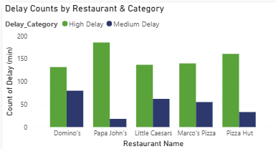
1. Papa John’s has the highest number of high delays compared to other restaurants, making it the most delayed in this dataset. 2. Domino’s, Little Caesars, and Marco’s Pizza show a similar pattern of delays, with high delays being more frequent than medium delays. 3. Pizza Hut has fewer medium delays than most, but its high delay count is still significant. 4. Overall, high delays dominate across all restaurants, suggesting that delay management is a common challenge.
Delay Patterns Across Restaurants

Slide 6
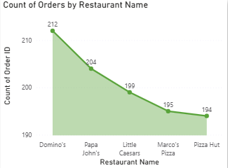
1. Domino’s has received the highest number of orders, standing at 212, which clearly makes it the most preferred option among customers. 2. Papa John’s is not far behind with 204 orders, followed by Little Caesars and Marco’s Pizza. 3. Pizza Hut is at the bottom with 194 orders, but the difference is quite small, indicating that all restaurants have a fairly similar level of demand.
Restaurant-wise Order Distribution

Slide 7
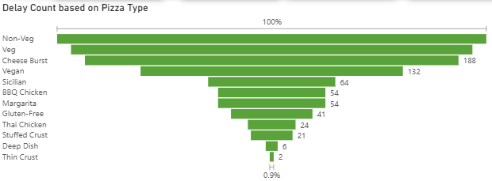
1. Non-Veg pizzas experience the most delays, followed closely by Veg pizzas and Cheese Burst. 2. Vegan and Sicilian pizzas also face noticeable delays but are significantly lower compared to Non-Veg and Veg. 3. Specialty pizzas like Thin Crust and Deep Dish have very few delays, indicating either low demand or better handling. 4. Overall, mainstream pizza types (Non-Veg, Veg, Cheese Burst) contribute the majority of delays, possibly due to higher order volumes.
Delivery Delays by Pizza Type

Slide 8
Key Insights from Pizza Delivery Analysis
Non-Veg pizzas have the highest delay rates, followed by Veg and Cheese Burst pizzas.
Weekends experience the most delays compared to weekdays.
Peak order times are around 6 PM to 8 PM.
Specialty pizzas like Thin Crust and Deep Dish have minimal delays, likely due to lower demand.
Domino’s emerged as the top-performing restaurant in terms of total orders.
Order trends by month showed that August recorded the highest number of orders, while July had the lowest.
The monthly delay trends showed that August experienced the highest number of delays, likely due to a peak in orders during that month.

Slide 9
Actionable Insights
Focus on improving delivery efficiency for pizzas that often face delays, like Non-Veg pizzas, to keep customers happy.
Plan for extra staff during peak months such as August, when orders are at their highest.
Make arrangements of resources in each location according to the pizzas that are commonly ordered there.
Run promotional offers or discounts during months with fewer orders, like July, to increase sales.
Use real-time tracking and monitoring to quickly identify and fix delay issues before they affect more customers.

Slide 10
Thank You!

